Slide 1
Halloween Project
Phenomena

Slide 2

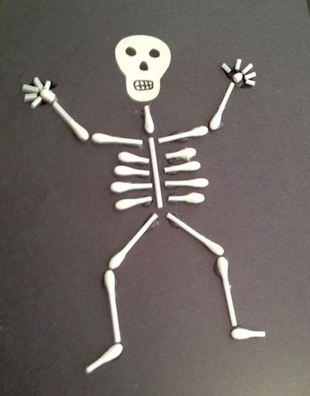
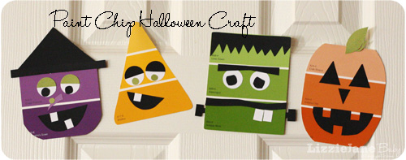
The Skeleton Project
A Trigger that makes people feel shocked.

Slide 3
Components
Ultrasonic Sensor
LEDs
Speaker
Motors

Slide 4
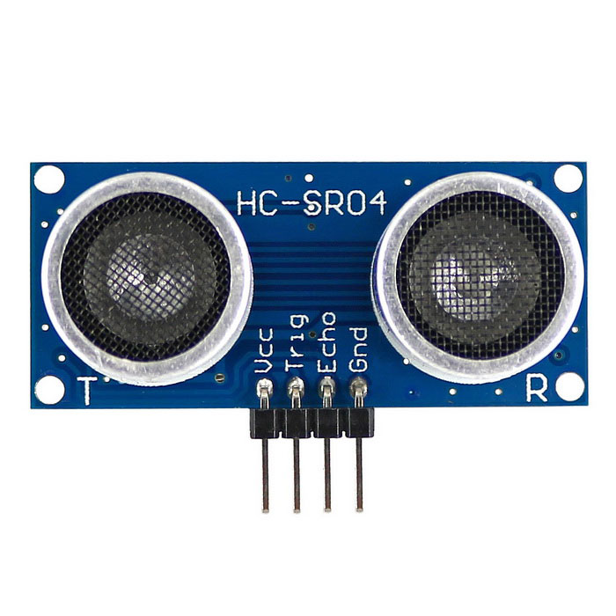
Ultrasonic Sensor
An Ultrasonic sensor is a device that can measure the distance to an object by using sound waves.
It measures distance by sending out a sound wave at a specific frequency and listening for that sound wave to bounce back. By recording the elapsed time between the sound wave being generated and the sound wave bouncing back, it is possible to calculate the distance between the sonar sensor and the object.

Slide 5
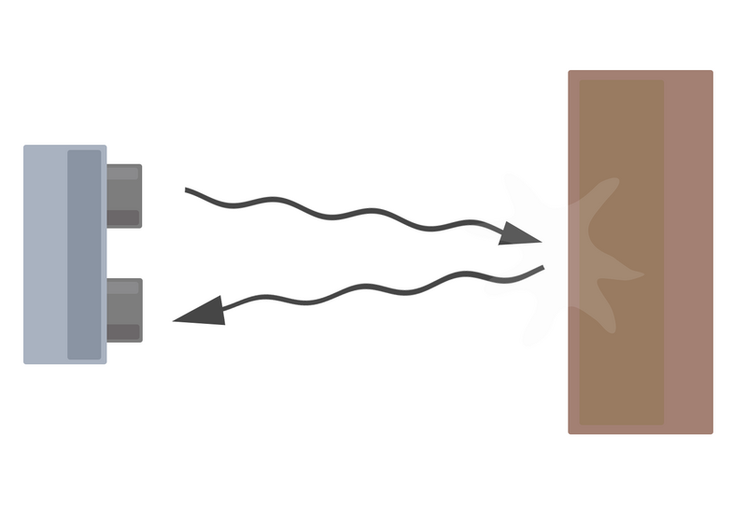
How Does It Work?
Distance = (speed of sound * time taken) /2

Slide 6
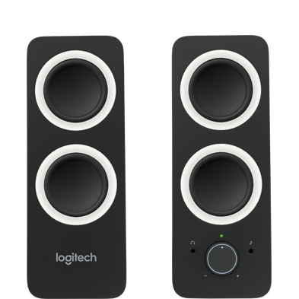
Speaker
When things shake about, or vibrate, they make the sounds we can hear in the world around us.
In order to translate an electrical signal into an audible sound, speakers contain an electromagnet: a metal coil which creates a magnetic field when an electric current flows through it.
http://www.explainthatstuff.com/loudspeakers.html

Slide 7
Project
Design
What do you want the skeleton look like?
What functions (features) do you wish the skeleton to have?
Lets do it!

Slide 8
Anyone wants to continue to work on the skeleton during the week so we can have it ready before Halloween?
Tuesday and Wednesday after school?

